Slide 1
Computer Fundamentals
Can we check whats happening to data?
Sequence & Repetition – Lesson 3

Slide 2
Do U remember?
Anything from last class?
Do U have any questions?
Pair up, discuss your questions.
See if U can find any answers in the diagram on the next slide:
Discuss the keywords in the diagram with your partner.

Slide 3
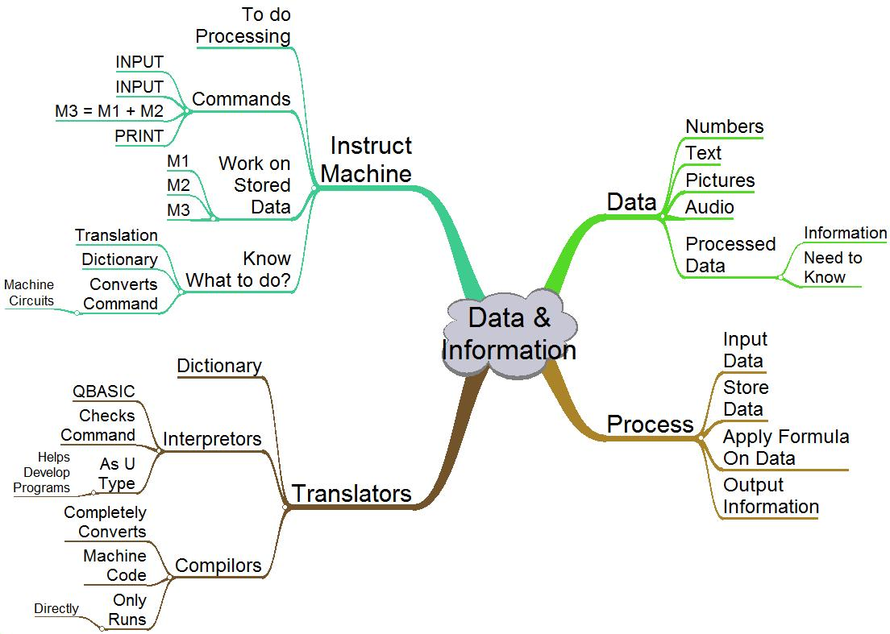
Questions?
Copy the diagram in your books

Slide 4
How much data can M1, M2 or M3 store?
The memory of a calculator stores numbers.
How big a number can it store?
What would U need to do to store very large numbers? Double memory?
Can the memory M of a calculator store characters like a, A, i.e. text?
The name of a memory in a computer is called a VARIABLE.

Slide 5
How are numbers/text stored?
Assignment:
Find out the types of variables in a computer.
How would the computer know which type to store?

Slide 6
Did your program work in Lab?
What would happen if you put the program lines in a wrong sequence?
INPUT M1
M3 = M1 + M2
INPUT M2
PRINT M3
Pair up. Discuss
INPUT M1
INPUT M2
M3 = M1 + M2
PRINT M3

Slide 7
What would happen?
Would the output be wrong?
Why? All the same lines are there.
Can we find out what the output would be?
How?

Slide 8
Should we follow data on each line?
The command on each line works on data.
If we observe what happens to data at each line, would we be able to work out the final output?
How can we follow the data on each line?
Pair up, discuss.

Slide 9
Can the following table be used?
Line Executed | M1 | M2 | M3 | Output Screen
Line 1
Line 2
Line 3
Line 4
Each pair to take ONE program.
a, b or c
Use the table to find the output.
Pairs to compare their output.
a
INPUT M1
M3 = M1 + M2
INPUT M2
PRINT M3
b
INPUT M1
INPUT M2
PRINT M3
M3 = M1 + M2
c
INPUT M2
INPUT M1
M3 = M1 + M2
PRINT M3

Slide 10
Explain/compare outputs on board
One pair to explain the output on the board for a, b and for c.
What is the purpose of the table?
Would such a table be useful to check any program that you have written?
As the table traces what happens to data on each line, it is called a
TRACE TABLE.

Slide 11
In last class there were many sums
6 & 4, 7 & 5, 13 & 15, 34 & 42, etc.
How many pairs did your program add?
Can the same program be used to add the other pairs of data?
How?

Slide 12
Group Presentations
Class to break up into four groups.
Each group to design instructions to add the remaining pairs of data.
Each group to put their instructions on a poster and explain to the rest of the class.

Slide 13
QBASIC has:
Commands that allow repeating the same instructions again and again.
If you know the number of times the instructions have to be repeated.
If you don’t know the number of times instructions have to be repeated.

Slide 14
Fit both sets to your instructions
FOR M4 = 1 TO 4
NEXT M4
WHILE M1 <> -1
WEND
How many pairs will this repetition handle? How? How can U use M1 to show that there are no more pairs?
This means
not equal to: ǂ

Slide 15
In the lab work in pairs:
Try both the repeating programs out in the QBASIC interpretor. Also try the wrong programs. Check Ur answers
Find the folder labYMI
In it find QBASIC folder
Find QB.exe Load QB
Write and run both programs
Add pairs of data, try again.

Slide 16
Answer Q for next class
In your textbook, find the chapter on variables – find out why different types of variables are required to store different types of data. How will you explain to the computer which type of data U are going to use?

